Slide 1

Alla Resheten
Project Manager
www.aegee.org/eap

Slide 2


Why was the project initiated?
Mobility of young people in EaP countries is restricted because of visa problem
There are limited Educational opportunities in Europe for young people from EaP countries
Young people in EaP countries are not taking an active role in the society
There are conflicts in the region

Slide 3
History of the project
November 2010–January 2011 : concept development
February - May2011 – concept development and project teams were created by members of AEGEE and external partners
Autumn 2011 – launch of the project with number of Action Days on Mobility and EaP Programme promotion
Since November 2011 – member of the EaP Civil Society Forum

Slide 4
Our aim
To ensure equal opportunities for the young people from Eastern Partnership countries* and EU member states.
Eastern Partnership countries:
  Armenia, Azerbaijan, Belarus, Georgia, Moldova and Ukraine

Slide 5
Focus Areas
Youth Mobility & Visa facilitation
Conflict Resolution
Active Citizenship

Slide 6
Overview of activities
Eastern Partnership Action Days (Budapest, Passau, Poznan, Baki, Prague, Tbilisi, Yerevan and Groningen).
Youth Mobility Action Days (Yerevan, Kyiv)
Conflict Resolution Action Day (Groningen)
Peace building in Europe YiA training (Oviedo, September 2012): 40 pax, best thematic event of 2012
Election Observation Mission in Ukraine (October 2012)
2 YiA conferences on the EaP-EU cooperation organised by AEGEE-Brno “EaP countries on the way of the EU integration” and AEGEE-Koln “Eastern Partnership: European Youths’ Perspective” in 2013: 70 pax in total

Slide 7
Overview of activities
  Conference on Youth Mobility organised in the European Parliament (2013): 70 pax as well as more than 200 people following live stream
  Exhibition held in European Parliament focused on the visa issue in the EaP region (2013)
  Armenia Model EU Conference 2012 (AMEU) organised by AEGEE-Yerevan (120 pax)
  Youth Participation in Elections: From EaP Countries to International Experience (2012) organised by AEGEE-Yerevan with 50 pax

Slide 8
Overview of activities
  Active participation in 5 NWMs, 2 EBMs and 6 Agorae (workshops, presentations, Fair)
  2 Summer Universities 2012 organised by AEGEE-Yerevan and AEGEE-Dnipropetrovsk+AEGEE-Katowice
  3 cultural events organised by AEGEE-Poznan (“I’m for the East!” festival, “I’m for the East 2!” festival and local initiative “Serce dla Gruzji” (Heart for Georgia))
  Participation to 4 external conferences focused on the EaP related issues and 3 EaP CSF

Slide 9
Overview of activities
  Youth Mobility Manual
  Around 10 research articles published on the Eastbook.eu portal
  Around 50 articles published on the project website
  Statement on observation mission towards Presidential elections in Azerbaijan submitted
  Statement on the situation in the EaP region before upcoming EaP-EU summit
  Facebook page with 1710 followers
  Webpage with more than 200 visits per month

Slide 10
Overview of activities
  Active member of the EaP CSF since November 2011
  Coordinator of the Youth sub-group of the Working Group 4 “Contact between people” since November 2012
  3 live team meetings: 1 in Yerevan and 2 in Brussels

Slide 11
Impact
With our activities we’ve reached directly around 5000 young Europeans
We’ve reached more than 15 000 young people through our publications and shared experience of participants of our events

Slide 12
Team
Total amount of members between January 2011 – October 2013 : 40 people
From which more than 20 stayed in the project for more than 1 year and actively contributed to its’ development

Slide 13
Thank you
Miroslaw Krzanik
Comite Directeur 2010-2011
Content Development team (Shushan, Armenak, Mariam, Lena)
All team members especially to:
  Shushan for being my right hand for 2 years and contributing a lot to the project
  Daryna for being and awesome PR manager for 2 years
  Elena and Lena for finding money for our activities
  Anne, Armenak, Adrian, Roland for taking super pro-active role in the project
  And every single person who have worked in the team
All locals who have organised activities with us
Comite Directeur 2011-2012, Comite Directeur 2012-2013 and Comite Directeur 2013-2014

Slide 14
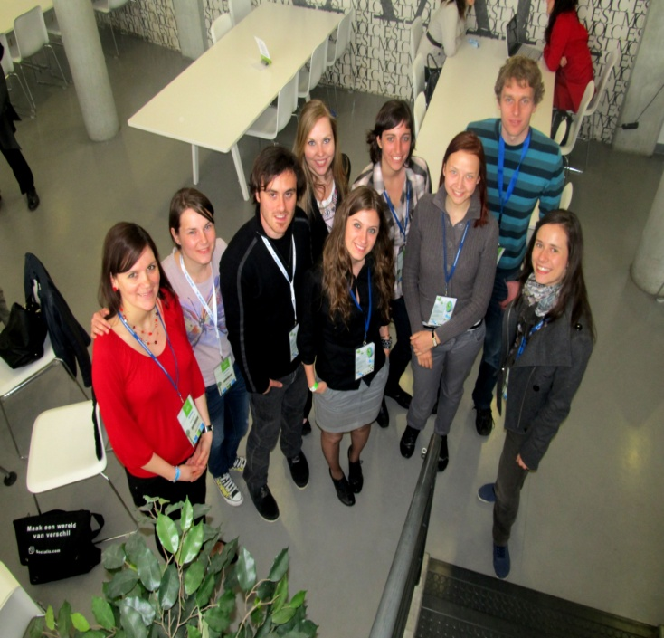
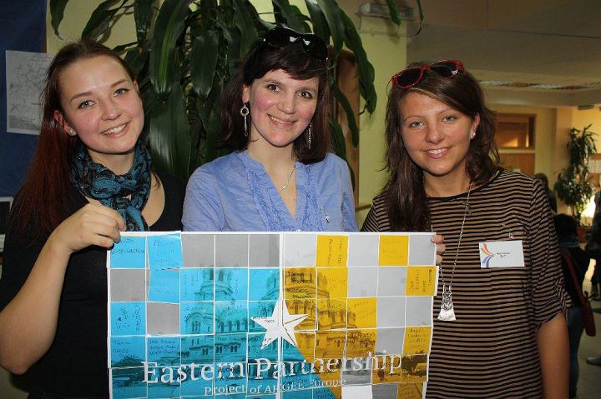
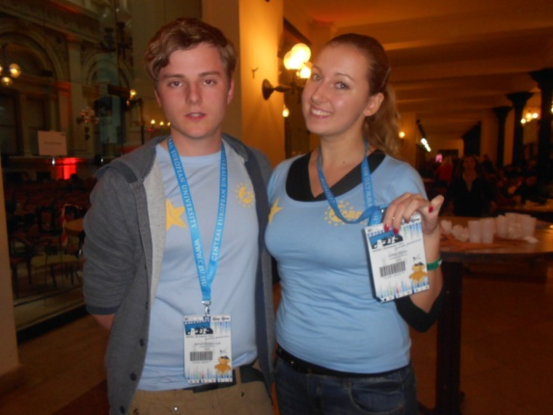
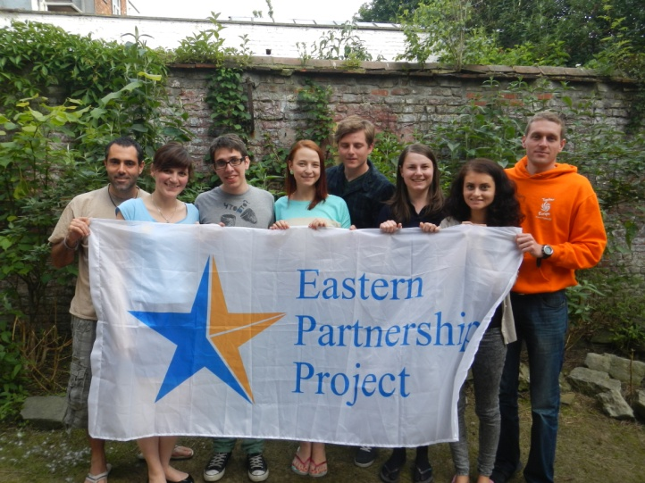
Thank you

Slide 15

WE SHOULD WORK TOGETHER TO ACHIEVE MORE
Visit Us: http://mail.aegee.org/eap/
LIKE US: www.facebook.com/AEGEE.EaP
CONTACT US: eap@aegee.org

